Slide 1

Unsupervised Machine Learning
Machine learning 2
Muhammed Elameiry
Senior Data Scientist, Banque Misr
Muhammed Elameiry
ITI
Feb 7, 2025

Slide 2
Anomaly Detection
Muhammed Elameiry
Muhammed Elameiry
ITI
ITI
Feb 7, 2025
Feb 7, 2025

Slide 3

Today’s Agenda
Anomaly Detection
Local Outlier Factor (LOF)
Isolation Forest
Muhammed Elameiry
ITI
Feb 7, 2025

Slide 4
Local Outlier Factor (LOF)
Local Outlier Factor (LOF) algorithm computes a score (called local outlier factor) reflecting the degree of abnormality of the observations. It measures the local density deviation of a given data point with respect to its neighbors. The idea is to detect the samples that have a substantially lower density than their neighbors.
What problem LOF solves LOF addresses the failure of global distance-based methods in datasets where normal behavior occurs at different densities across the feature space.
Type of anomalies detected
Local anomalies: points that are normal globally but abnormal relative to nearby points
Not designed for purely global isolation
Particularly effective in varying-density datasets
Muhammed Elameiry
Muhammed Elameiry
ITI
ITI
Feb 7, 2025
Feb 7, 2025
4

Slide 5
Why Distance Alone Is Not Enough
Distance-based anomaly detection assumption Points that are far from most other points are anomalies.
Why this fails
Real datasets often contain:
Dense clusters
Sparse clusters
Gradual density changes
A point in a sparse cluster may be far from others but still locally normal
Core limitation Global distance ignores local context.
Key contrast
Global distance: How far am I from everyone?
Local density: How crowded am I compared to my neighbors?
LOF adopts the second perspective.
Muhammed Elameiry
Muhammed Elameiry
ITI
ITI
Feb 7, 2025
Feb 7, 2025
5

Slide 6
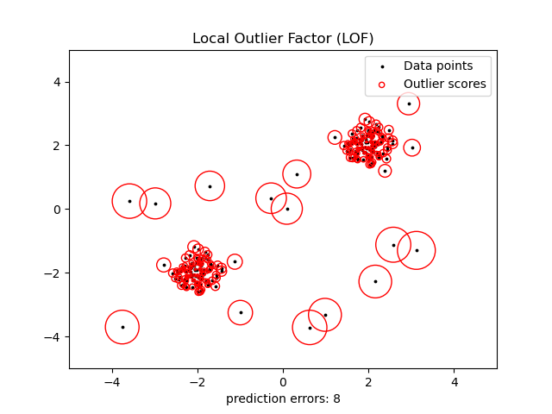
Muhammed Elameiry
Muhammed Elameiry
ITI
ITI
Feb 7, 2025
Feb 7, 2025
6

Slide 7
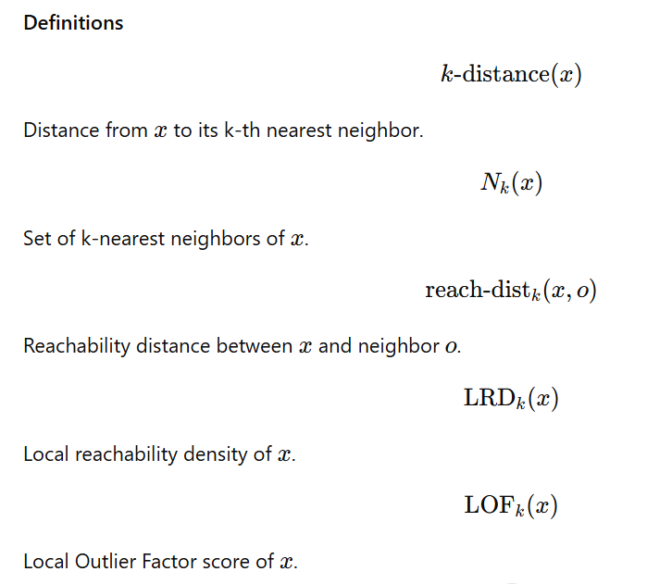

Step-by-Step LOF Algorithm
For each data point $x$:
Step 1 — k-Nearest Neighbors
Identify the set $N_{k}\left(x\right)$
Step 2 — k-distance
Compute the distance from $x$to its k-th nearest neighbor
Step 3 — Reachability Distance
Stabilize distances using neighbors’ local scale
Step 4 — Local Reachability Density (LRD)
Convert reachability distances into a local density estimate
Step 5 — LOF Score
Compare the density of $x$to the average density of its neighbors
Muhammed Elameiry
Muhammed Elameiry
ITI
ITI
Feb 7, 2025
Feb 7, 2025

Slide 8
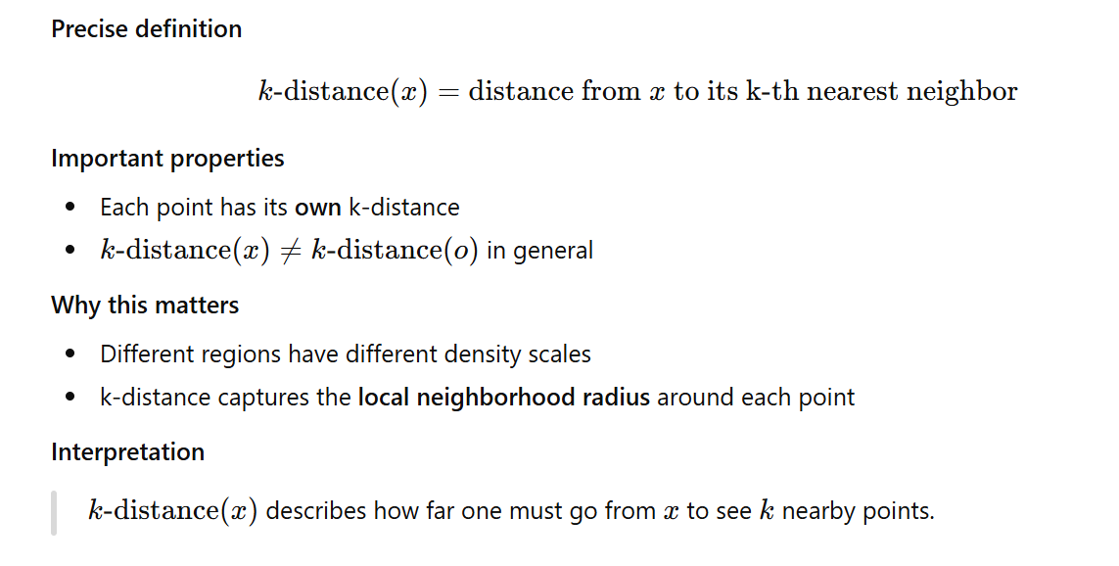
What is $k\text{−}\text{distance}\left(⋅\right)$?
Muhammed Elameiry
Muhammed Elameiry
ITI
ITI
Feb 7, 2025
Feb 7, 2025
8

Slide 9
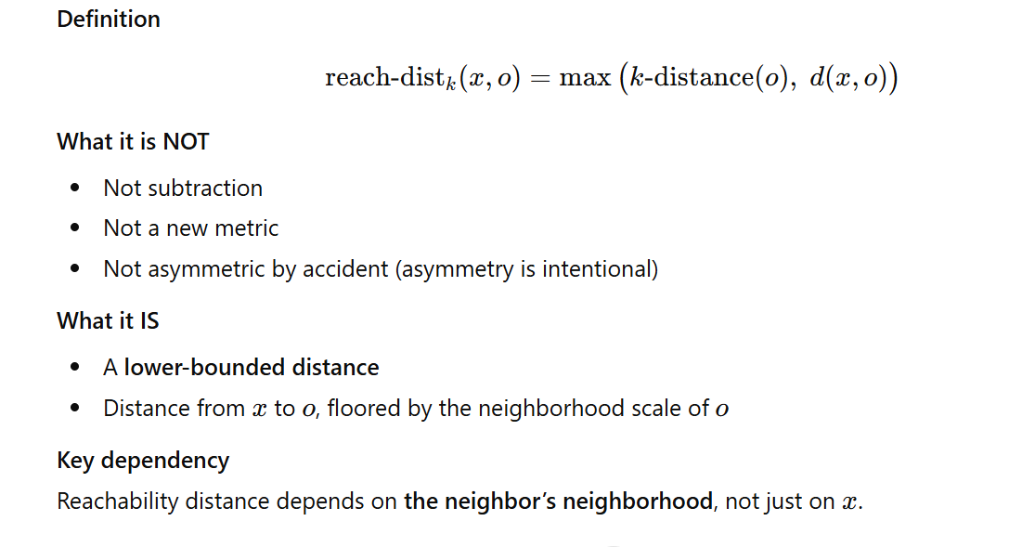
What is Reachability Distance?
Muhammed Elameiry
Muhammed Elameiry
ITI
ITI
Feb 7, 2025
Feb 7, 2025
9

Slide 10
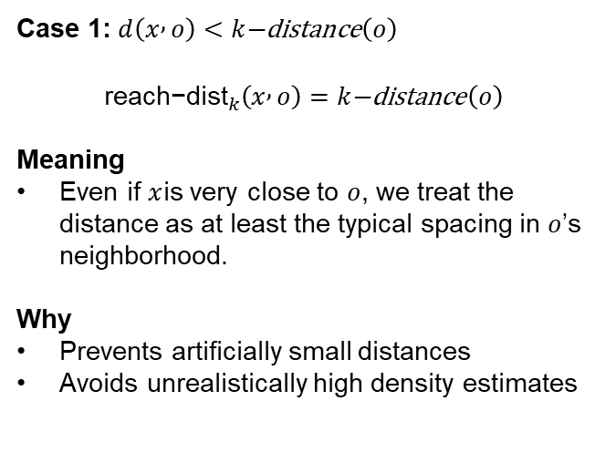
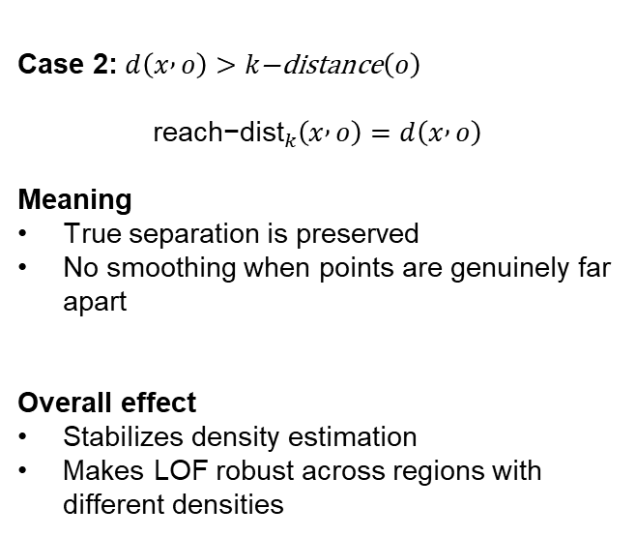
Why We Take the MAX in Reachability Distance
Case 2: $d\left(x , o\right)>k\text{−}\text{distance}\left(o\right)$
$${\text{reach}\text{−}\text{dist}}_{k}\left(x , o\right)=d\left(x , o\right)$$
Meaning
True separation is preserved
No smoothing when points are genuinely far apart
Overall effect
Stabilizes density estimation
Makes LOF robust across regions with different densities
Case 1: $d\left(x , o\right)<k\text{−}\text{distance}\left(o\right)$
$${\text{reach}\text{−}\text{dist}}_{k}\left(x , o\right)=k\text{−}\text{distance}\left(o\right)$$
Meaning
Even if $x$is very close to $o$, we treat the distance as at least the typical spacing in $o$’s neighborhood.
Why
Prevents artificially small distances
Avoids unrealistically high density estimates
Muhammed Elameiry
Muhammed Elameiry
ITI
ITI
Feb 7, 2025
Feb 7, 2025
10

Slide 11
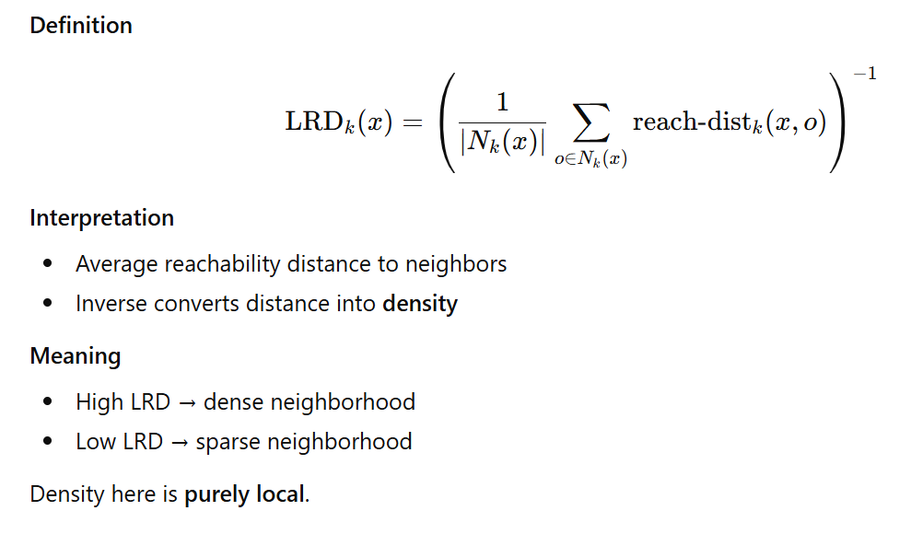
Local Reachability Density (LRD)
Muhammed Elameiry
Muhammed Elameiry
ITI
ITI
Feb 7, 2025
Feb 7, 2025
11

Slide 12
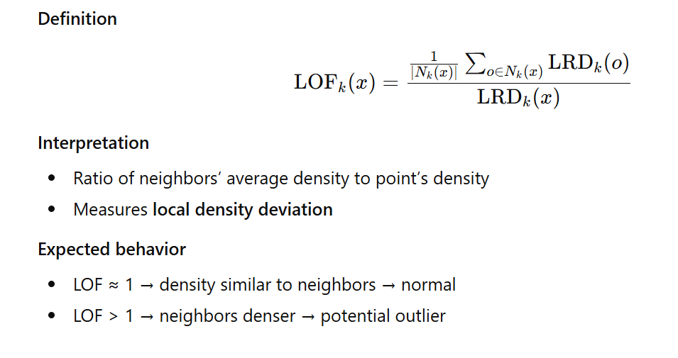
What is Reachability Distance?
Muhammed Elameiry
Muhammed Elameiry
ITI
ITI
Feb 7, 2025
Feb 7, 2025
12

Slide 13
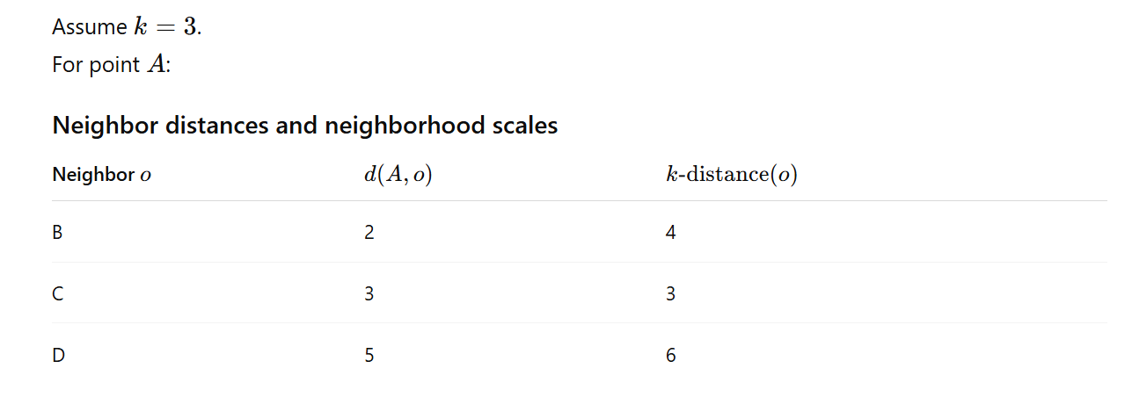
Worked Numerical Example
Muhammed Elameiry
Muhammed Elameiry
ITI
ITI
Feb 7, 2025
Feb 7, 2025
13

Slide 14
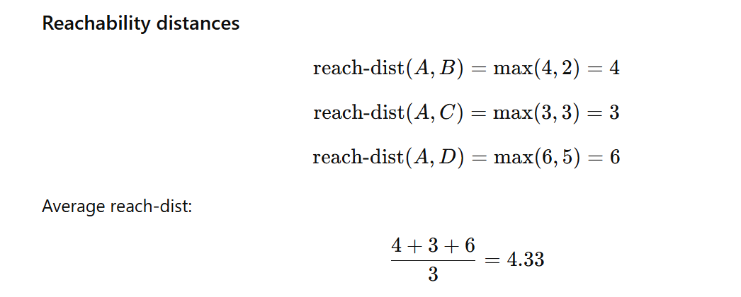
Worked Numerical Example
Muhammed Elameiry
Muhammed Elameiry
ITI
ITI
Feb 7, 2025
Feb 7, 2025
14

Slide 15
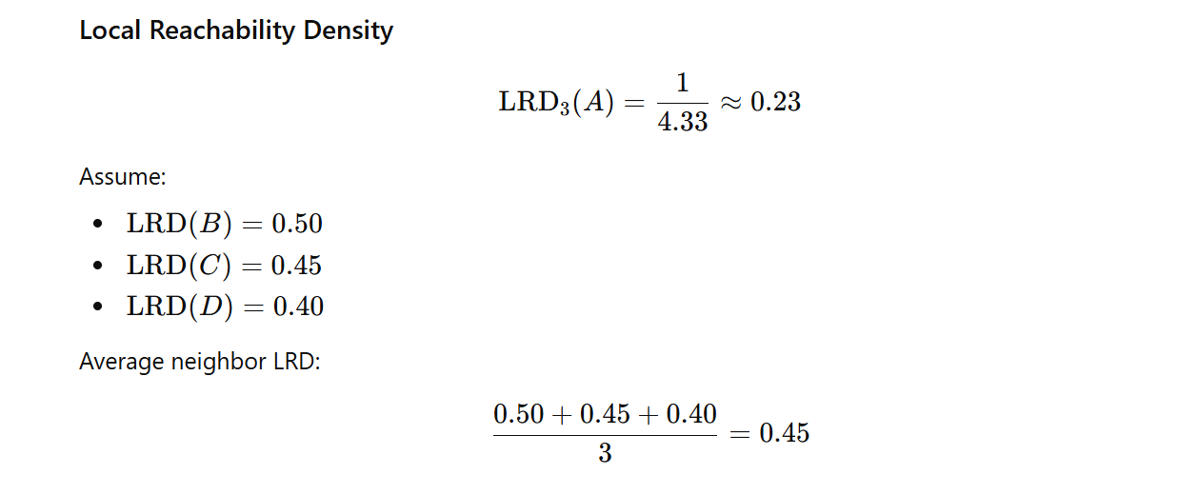
Worked Numerical Example
Muhammed Elameiry
Muhammed Elameiry
ITI
ITI
Feb 7, 2025
Feb 7, 2025
15

Slide 16
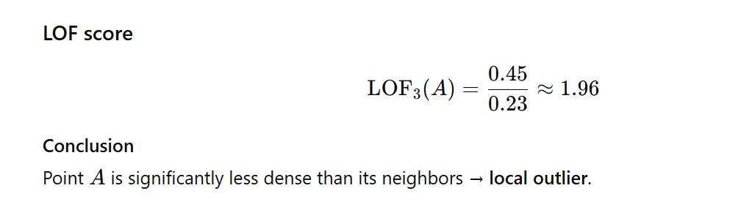
Worked Numerical Example
LOF ≈ 1 Density comparable to neighbors → normal
LOF > 1 Local density lower than neighbors → anomalous
Muhammed Elameiry
Muhammed Elameiry
ITI
ITI
Feb 7, 2025
Feb 7, 2025
16

Slide 17
Isolation forest
Muhammed Elameiry
Muhammed Elameiry
ITI
ITI
Feb 7, 2025
Feb 7, 2025

Slide 18
Isolation forest
Definition Isolation Forest is an unsupervised anomaly detection algorithm that identifies anomalies by isolating observations using random splits. Points that are isolated with fewer splits are considered anomalous.
Problem it solves Detects anomalies without computing distances or densities, avoiding common failures in complex or high-dimensional data.
Why it works well in high dimensions It relies on random partitioning, not geometry. Distances and densities degrade in high dimensions; random splits do not.
Muhammed Elameiry
Muhammed Elameiry
ITI
ITI
Feb 7, 2025
Feb 7, 2025
18

Slide 19
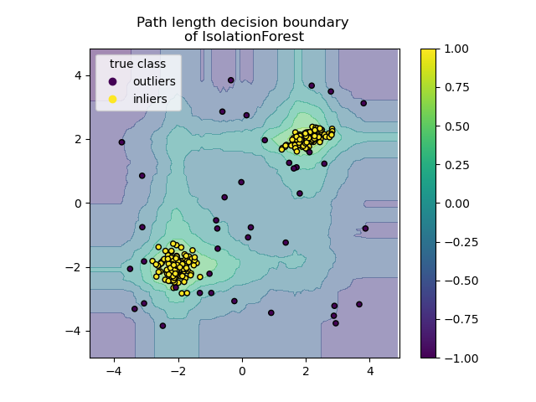
Isolation forest
Traditional anomaly detection:
Measures how far a point is
Or how dense its neighborhood is
Isolation Forest:
Does not model normal behavior
Does not define neighborhoods
Does not estimate probabilities
Core idea
Anomalies are easier to isolate than normal points.
Normal points are surrounded by many others. Anomalies are few and lie in sparse regions.
Muhammed Elameiry
ITI
Feb 7, 2025
19

Slide 20
Isolation forest
Isolation Forest builds trees using:
Random feature selection
Random split values
Recursive partitioning
Each split divides the data into two parts.
Why randomness helps
No assumptions about data shape
No optimization objective
Quickly separates rare points
Randomness makes the algorithm simple, fast, and robust.
Why Anomalies Require Fewer Splits
Dense regions:
Many points clustered together
Many splits needed to separate one point
Sparse regions:
Few points
One or two splits often enough
Key observation
Short path → easy to isolate → anomaly
Long path → hard to isolate → normal
This property holds across dimensions.
Muhammed Elameiry
ITI
Feb 7, 2025
20

Slide 21
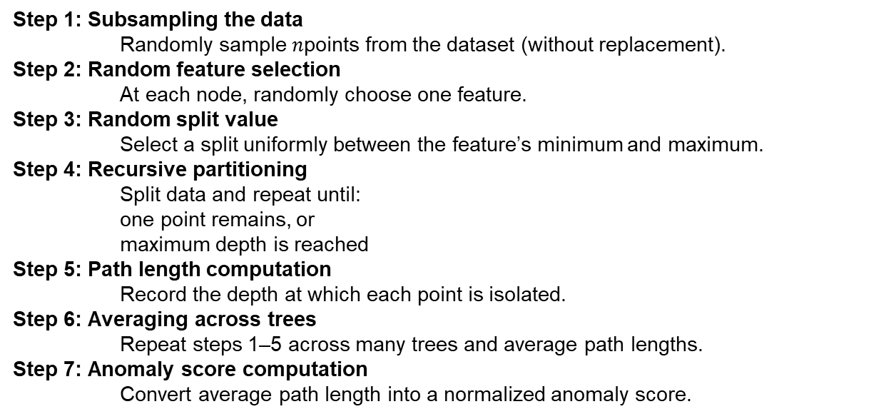
Isolation forest - Algorithm Overview
Step 1: Subsampling the data Randomly sample $n$points from the dataset (without replacement).
Step 2: Random feature selection At each node, randomly choose one feature.
Step 3: Random split value Select a split uniformly between the feature’s minimum and maximum.
Step 4: Recursive partitioning Split data and repeat until:
one point remains, or
maximum depth is reached
Step 5: Path length computation Record the depth at which each point is isolated.
Step 6: Averaging across trees Repeat steps 1–5 across many trees and average path lengths.
Step 7: Anomaly score computation Convert average path length into a normalized anomaly score.
Muhammed Elameiry
ITI
Feb 7, 2025
21

Slide 22
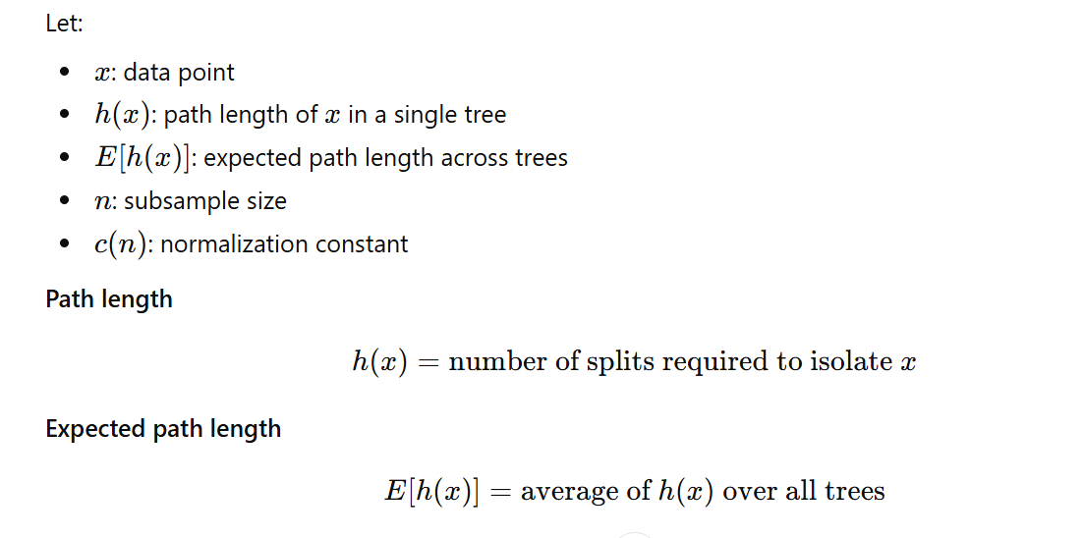
Isolation forest
Muhammed Elameiry
ITI
Feb 7, 2025
22

Slide 23
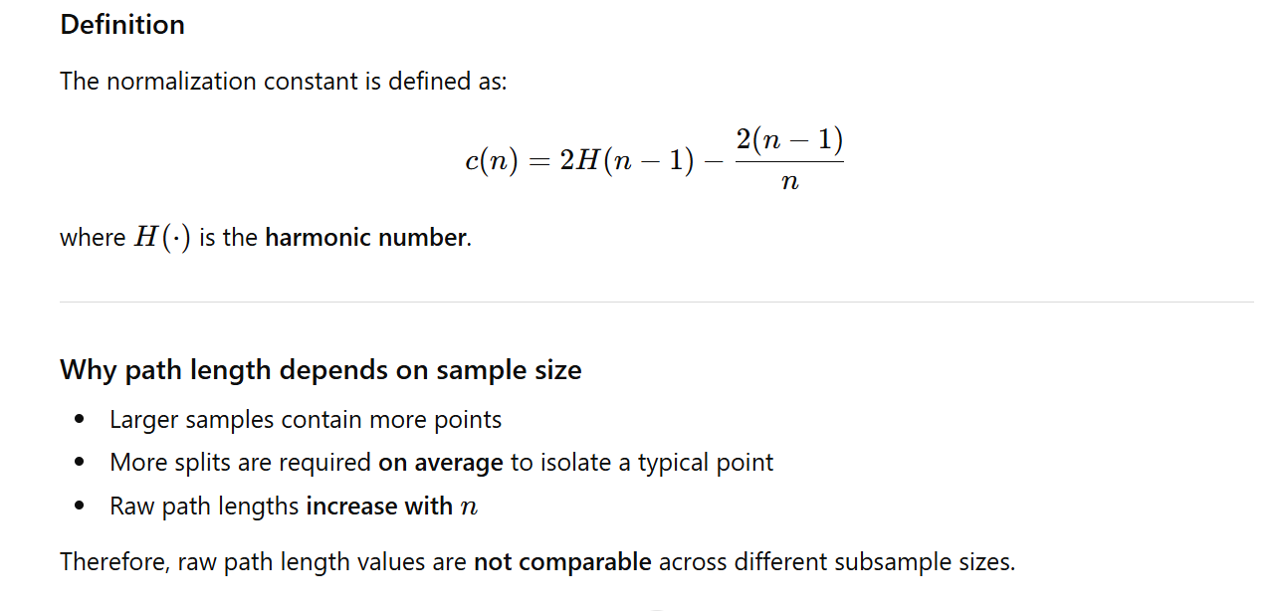
Normalization Constant $c\left(n\right)$: Expected Path Length
Muhammed Elameiry
ITI
Feb 7, 2025
23

Slide 24
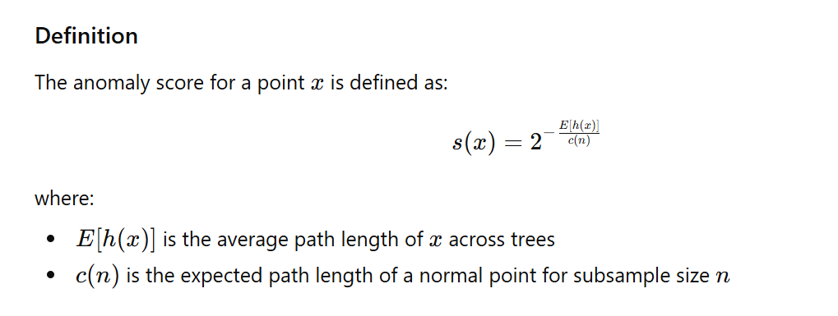
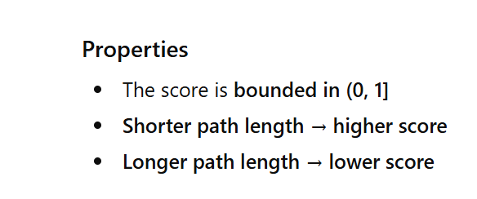
Anomaly Score Function
Muhammed Elameiry
ITI
Feb 7, 2025
24

Slide 25
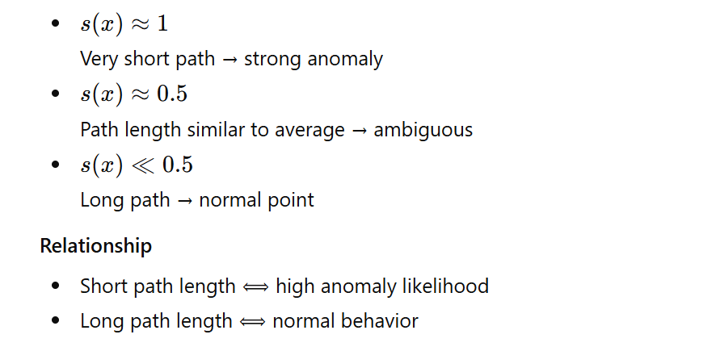
Anomaly Score Interpretation
Muhammed Elameiry
ITI
Feb 7, 2025
25

